Slide 1


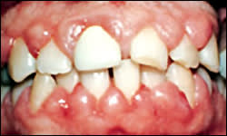
GINGIVAL ENLARGEMENT
RUNGTA COLLEGE OF DENTAL SCIENCES AND RESEARCH,BHILAI
Dr PUSHPENDRA YADAV
Senior Lecturer
Dept of Periodontology

Slide 2
SPECIFIC LEARNING OBJECTIVES
CORE AREAS | DOMAIN | CATEGORY
INTRODUCTION | Affective | Desire to know
CLASSIFICATION | Cognitive | Must to know
INFLAMMATARY ENLARGEMENT | Cognitive | Must to know
DRUG INDUCED ENLARGEMENT | Cognitive | Must to know
IDIOPATHIC ENLARGEMENT | Cognitive | Must to know
ENLARGEMENTS ASSOCIATED WITH SYSTEMIC DISEASES | Cognitive | Must to know
NEOPLASTIC ENLARGEMENT | Cognitive | Must to know
FALSE ENLARGEMENT | Cognitive | Must to know

Slide 3

CONTENT
PART-I
Introduction
Classification
Inflammatory enlargement
    Chronic
    Acute
    PART--II
Drug-induced enlargement
    Anti-Convulsants
    Immunosuppresants
    Calcium Channel Blockers

Slide 4
Idiopathic Gingival enlargement
PART-III
Enlargements associated with systemic diseases or conditions
Neoplastic enlargements
False enlargement
Summary
Reference

Slide 5
INTRODUCTION

Slide 6
Increase in size of gingiva is termed as gingival enlargement.
Synonyms: Gingival overgrowth
Old terms: Hypertrophic gingivitis
Gingival hyperplasia
The different types of gingival overgrowth vary according to the etiologic factors and pathologic processes that produce them.

Slide 7
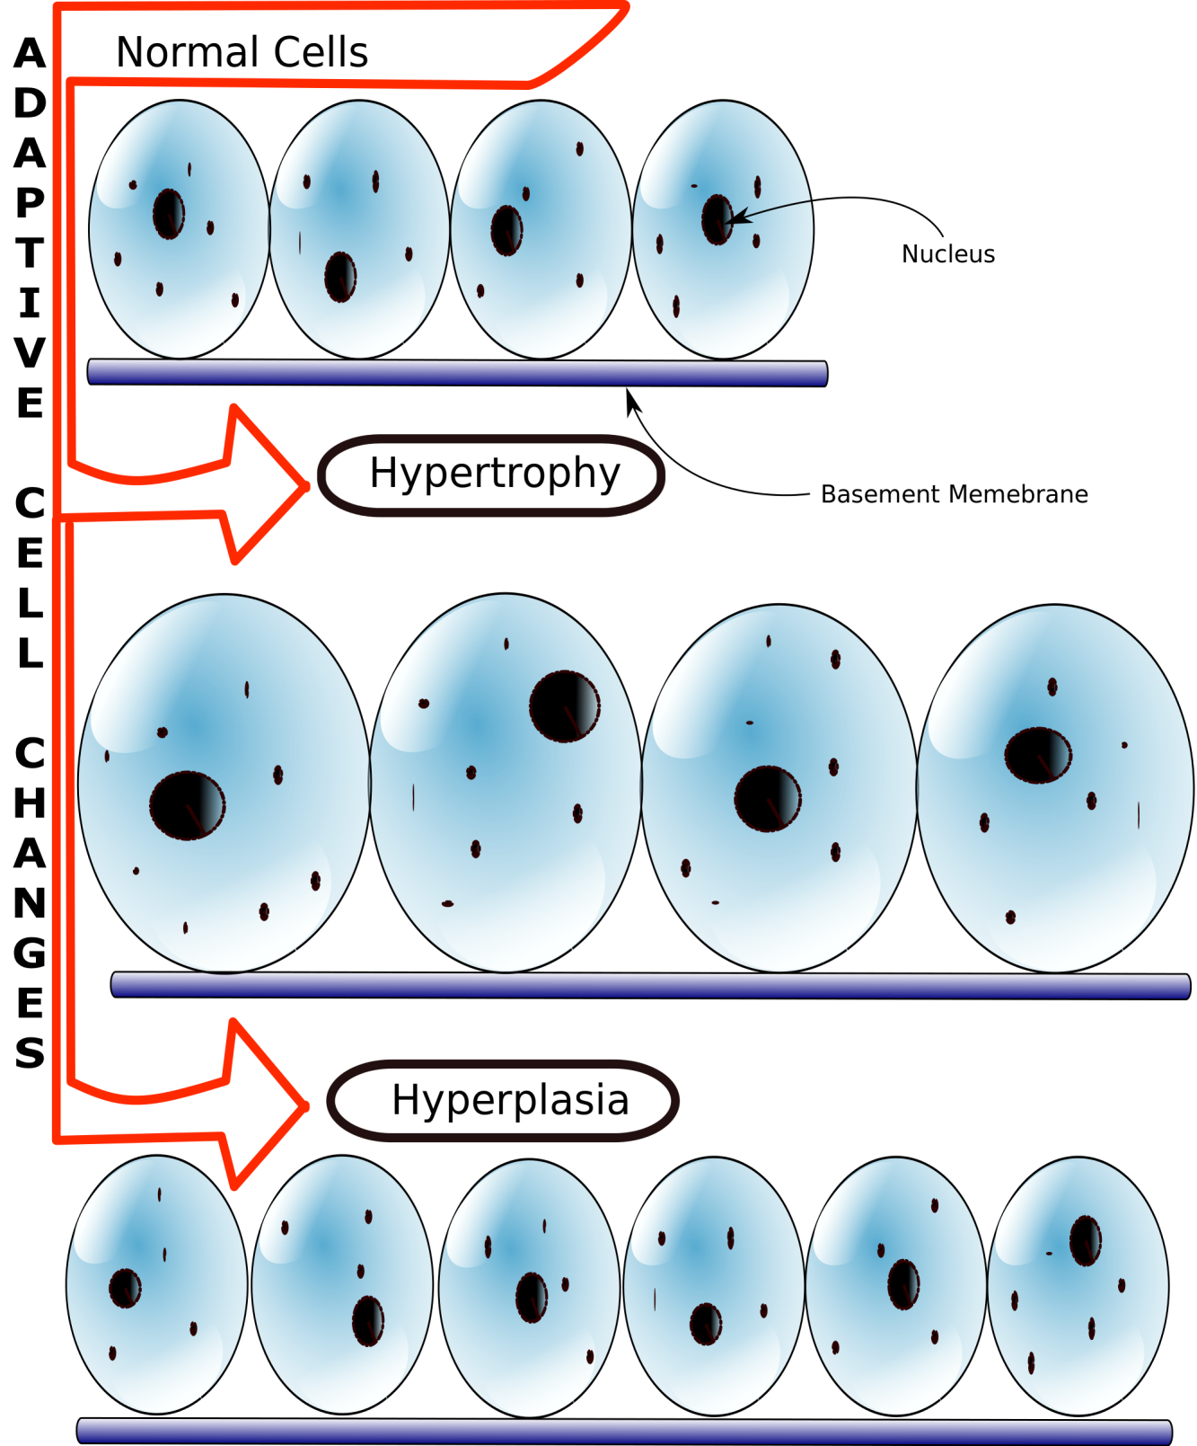

Slide 8
Hyperplastic, hypertrophic, and fibrotic changes are observed during gingival enlargement and cannot be accurately differentiated.

Slide 9
CLASSIFICATION

Slide 10
A. According to etiologic factors and pathologic changes:
I. Inflammatory enlargement
    Acute
    chronic
II. Drug-induced enlargement

Slide 11
III. Enlargements associated with systemic diseases or conditions
1. Conditioned enlargement
    Pregnancy
    Puberty
    Vitamin C deficiency
    Plasma cell gingivitis
    Nonspecific conditioned enlargement (pyogenic granuloma)

Slide 12
2. Systemic diseases causing gingival enlargement
    Leukemia
    Granulomatous diseases (e.g., Wegener’s granulomatosis, sarcoidosis)
IV. Neoplastic enlargement (gingival tumors)
    Benign tumors
    Malignant tumors
V. False enlargement
  Underlying osseous lesions
  Underlying dental tissues.

Slide 13
B. According to criteria of location and distribution, gingival enlargement is designated as follows
Localized: Limited to the gingiva adjacent to a single tooth or group of teeth.
Generalized: Involving the gingiva throughout the mouth.
Marginal: Confined to the marginal gingiva.
Papillary: Confined to the interdental papilla.
Diffuse: Involving the marginal and attached gingivae and papillae.
Discrete: An isolated sessile or pedunculated, tumorlike enlargement

Slide 14
C. The degree of gingival enlargement can be scored as follows:
Grade 0: No signs of gingival enlargement
Grade I: Enlargement confined to interdental papilla
Grade II: Enlargement involves papilla and marginal gingiva
Grade III: Enlargement covers three quarters or more of the crown

Slide 15
INFLAMMATORY ENLARGMENT

Slide 16
Gingival enlargement may result from chronic or acute inflammatory changes
In addition, inflammatory enlargements usually are a secondary complication to any of the other types of enlargement, creating a combined gingival enlargement.

Slide 17
CHRONIC INFLAMMATORY ENLARGMENT

Slide 18
Originates as a slight ballooning of the inter-dental papilla and marginal gingiva
Early stages - life preserver-shaped bulge around the involved teeth
Increase in size until it covers part of the crowns
Localized or generalized
Progresses slowly and painlessly

Slide 19
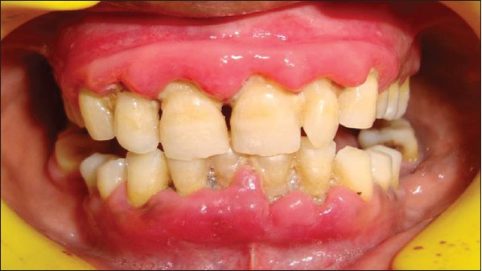
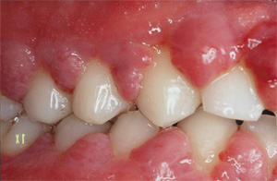

Slide 20
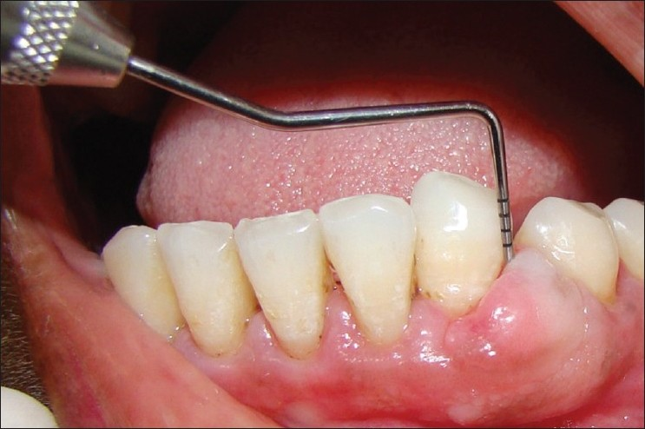
Discrete sessile or pedunculated mass
Interproximal or on the marginal or attached
Slow growing
Painless
May undergo spontaneous reduction in size, followed by exacerbation and continued enlargement
Painful uclers may occur in folds of mass
Ocassionally….

Slide 21
Etiology:
Prolonged exposure to dental plaque
Factors that favour plaque accumulation and retention:
Poor oral hygiene
Irritation by anatomic abnormalities
Improper restorative and orthodontic appliances

Slide 22
Histologically:
Shows exudative and proliferative features of chronic inflammation.
Deep red or bluish red lesions that are soft and friable with a smooth shiny surface and bleed easily.
Preponderance of inflammatory cells and fluid, with vascular engorgement, new capillary formation, and associated degenerative changes.
Lesions that are pink, firm and resilient have greater fibrotic component with abundance of fibroblasts and collagen fibers

Slide 23
Gingival Changes Associated with Mouth Breathing:
Gingivitis and gingival enlargement are often seen in mouth breathers
Commonly effects maxillary anterior region
Gingiva appears red and edematous, with a diffuse surface shininess of the exposed area
Its harmful effect is generally attributed to irritation from surface dehydration

Slide 24
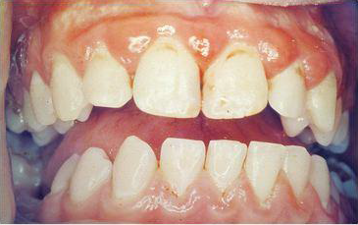
Notes:
.

Slide 25
ACUTE INFLAMMATORY ENLARGMENT

Slide 26
Meng 1999
Gingival abscess
Periodontal abscess
Pericoronal abscess

Slide 27
Gingival abscess:
It is a localized, painful, rapidly expanding lesion of sudden onset caused by injury to the gingiva, such as impaction of foreign bodies.
Limited to marginal gingiva or interdental papilla.
May occur in presence or absence of periodontal pocket.

Slide 28
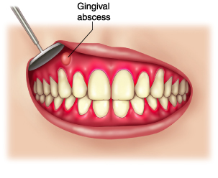
Etiology: Foreign substance forcefully embedded into the gingiva carrying bacteria deep into the tissues
Eg: -Toothbrush bristle
-Piece of apple core

Slide 29
CLINICAL FEATURES
Pain, swelling and erythema.
Early stages - red swelling with a smooth, shiny surface.
24 to 48 hours - becomes fluctuant and pointed with a surface orifice from which a purulent exudates may be expressed.
Adjacent teeth are sensitive to percussion.
Ruptures spontaneously, if permitted to progress.

Slide 30
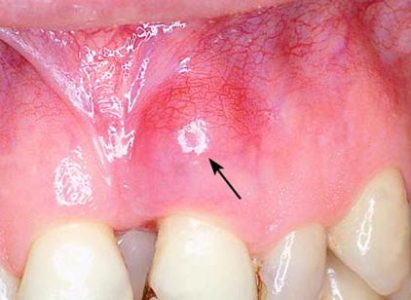
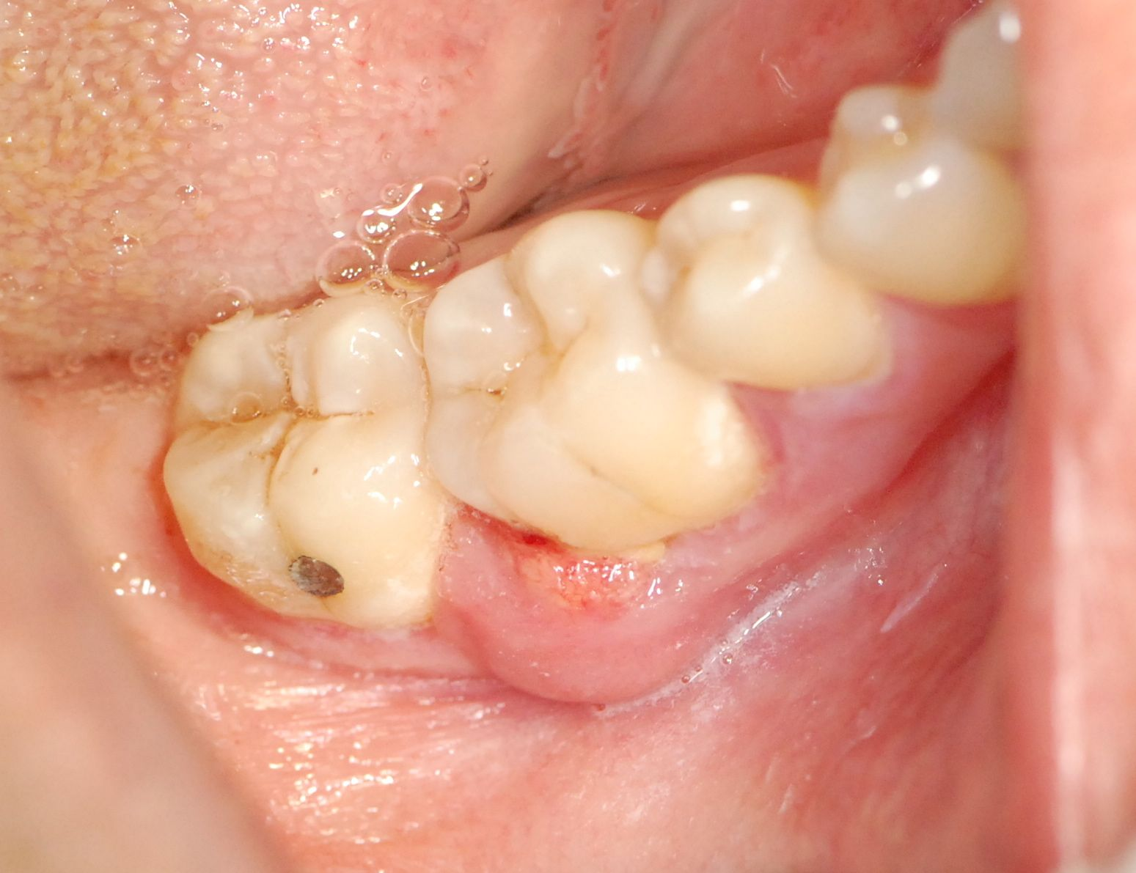

Slide 31
Histopathology.
The gingival abscess consists of a purulent focus in the connective tissue, surrounded by a diffuse infiltration of polymorphonuclear leukocytes (PMNs), edematous tissue, and vascular engorgement.
The surface epithelium has varying degrees of intra-cellular and extracellular edema, invasion by leukocytes, and sometimes ulceration

Slide 32
DRUG INDUCED GINGIVAL ENLARGMENT

Slide 33
Gingival enlargement is a well-known consequence of the administration of some anticonvulsants, immunosuppressants, and calcium channel blockers and may create speech, mastication, tooth eruption, and aesthetic problems.
Clinical and microscopic features of the enlargements caused by the different drugs are similar

Slide 34
Clinical features:
Starts as a painless, beadlike enlargement of the interdental papilla and extends to the facial and lingual gingival margins
As the condition progresses, the marginal and papillary enlargements unite & develop into a massive tissue fold covering a considerable portion of the crowns
May interfere with occlusion
may occur in mouths with little or no plaque and may be absent in mouths with abundant deposits

Slide 35
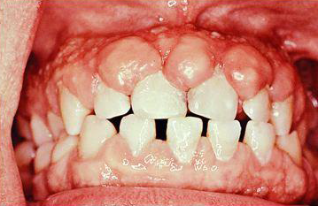
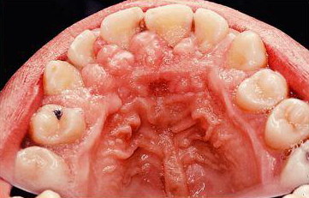

Slide 36
Uncomplicated by inflammation:
The lesion is mulberry shaped, firm, pale pink, and resilient, with a minutely lobulated surface and no tendency to bleed
The enlargement characteristically appears to project from beneath the gingival margin, from which it is separated by a linear groove
Difficult plaque control secondary inflammation

Slide 37
Secondary inflammatory changes increase size of the lesion caused by the drug and also produce a red or bluish red discoloration, obliterate the lobulated surface demarcations, and increase bleeding tendency
Generalized but more in maxillary & mandibular anterior region
Does not effect edentulous areas and disappear on extraction of teeth

Slide 38
Hassell et al. have hypothesized that in non-inflamed gingiva, fibroblasts are less active or even quiescent and do not respond to circulating phenytoin, whereas fibroblasts within inflamed tissue are in an active state as a result of the inflammatory mediators and the endogenous growth factors present
Genetic predisposition is a suspected factor in determining whether a person treated with phenytoin will develop gingival enlargement or not

Slide 39
The enlargement is chronic and slowly increases in size
When surgically removed, it recurs
Spontaneous disappearance occurs within a few months after discontinuation of the drug

Slide 40
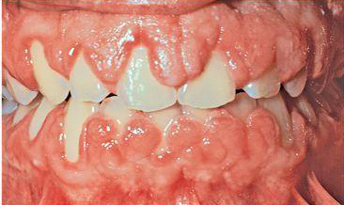

Slide 41
Histologically:
Pronounced hyperplasia of the connective tissue and epithelium
Acanthosis of the epithelium, and elongated rete pegs extend deep into the connective tissue, which exhibits densely arranged collagen bundles with an increase in the number of fibroblasts and new blood vessels
An abundance of amorphous ground substance has also been reported

Slide 42
Cyclosporine enlargements usually have a more highly vascularized connective tissue with foci of chronic inflammatory cells, particularly plasma cells
Recurring phenytoin enlargements appear as granulation tissue composed of numerous young capillaries and fibroblasts and irregularly arranged collagen fibrils with occasional lymphocytes

Slide 43
The “mature”-phenytoin enlargement has a fibroblast-to-collagen ratio that is equal to that of normal gingiva from normal individuals, which suggests that, at some point in the development of the lesion, fibroblastic proliferation must have been abnormally high

Slide 44
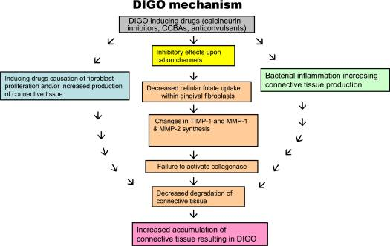
PATHOGENESIS

Slide 45
SUMMARY
GE is one of the commonly encountered entity in the clinic & has various implications like niches for infection & esthetic concern
Diagnosis of the exact nature of enlargement & etiologic factor plays a critical role in elimination of exaggerated lesions

Slide 46
REFERENCE
Newman MG, Takei HH, Klokkevold PR, Carranza FA. Carranza’s clinical periodontology, 10th ed. Saunders Elsevier; 2007.
Lindhe J, Lang NP and Karring T. Clinical Periodontology and Implant Dentistry. 6th ed. Oxford (UK): Blackwell Publishing Ltd.; 2015.
Newman MG, Takei HH, Klokkevold PR, Carranza FA. Carranza’s clinical periodontology, 13th ed. Saunders Elsevier; 2018.

Slide 47
THANK YOU

